Slide 1
Object-Oriented Software Engineering
Practical Software Development using UML and Java
  Chapter 8:
  Modelling Interactions and Behaviour

Slide 2
8.1 Interaction Diagrams
Interaction diagrams are used to model the dynamic aspects of a software system
  They help you to visualize how the system runs.
  An interaction diagram is often built from a use case and a class diagram.
    The objective is to show how a set of objects accomplish the required interactions with an actor.
© Lethbridge/Laganière 2005
Chapter 8: Modelling Interactions and Behaviour

Slide 3
Interactions and messages
  Interaction diagrams show how a set of actors and objects communicate with each other to perform:
    The steps of a use case, or
    The steps of some other piece of functionality.
  The set of steps, taken together, is called an interaction.
  Interaction diagrams can show several different types of communication.
    E.g. method calls, messages send over the network
    These are all referred to as messages.
© Lethbridge/Laganière 2005
Chapter 8: Modelling Interactions and Behaviour

Slide 4
Elements found in interaction diagrams
  Instances of classes
    Shown as boxes with the class and object identifier underlined
  Actors
    Use the stick-person symbol as in use case diagrams
  Messages
    Shown as arrows from actor to object, or from object to object
© Lethbridge/Laganière 2005
Chapter 8: Modelling Interactions and Behaviour

Slide 5
Creating interaction diagrams
You should develop a class diagram and a use case model before starting to create an interaction diagram.
  There are two kinds of interaction diagrams:
    Sequence diagrams
    Collaboration diagrams
© Lethbridge/Laganière 2005
Chapter 8: Modelling Interactions and Behaviour

Slide 6
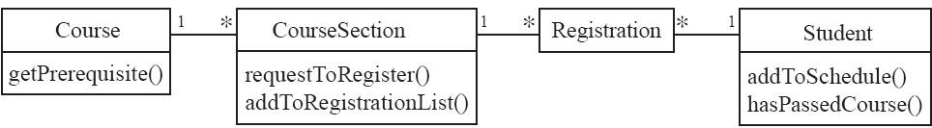
Sequence diagrams – an example
This static class diagram shows class
methods, but not how they are called.
© Lethbridge/Laganière 2005
Chapter 8: Modelling Interactions and Behaviour

Slide 7
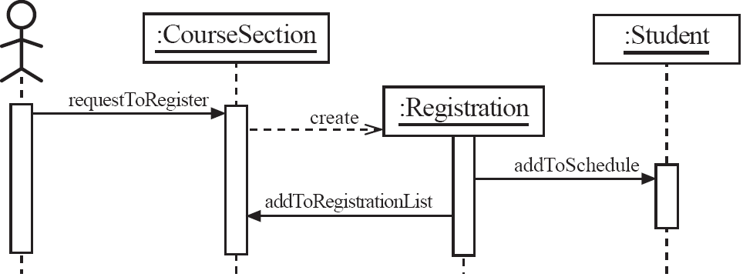
Sequence diagrams – an example
© Lethbridge/Laganière 2005
Chapter 8: Modelling Interactions and Behaviour

Slide 8
Sequence diagrams
A sequence diagram shows the sequence of messages exchanged by the set of objects performing a certain task
  The objects are arranged horizontally across the diagram.
  An actor that initiates the interaction is often shown on the left.
  The vertical dimension represents time.
  A vertical line, called a lifeline, is attached to each object or actor.
  The lifeline becomes a broad box, called an activation box during the live activation period.
  A message is represented as an arrow between activation boxes of the sender and receiver.
    A message is labelled and can have an argument list and a return value.
© Lethbridge/Laganière 2005
Chapter 8: Modelling Interactions and Behaviour

Slide 9
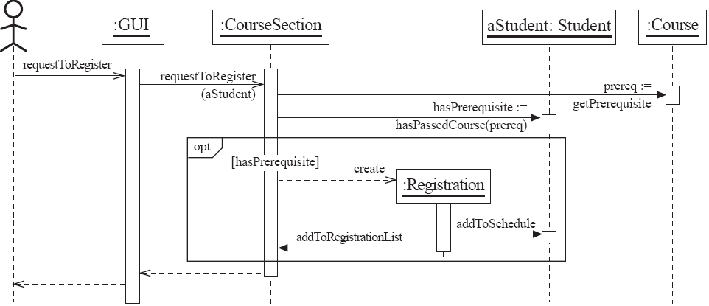
Sequence diagrams – same example, more details
© Lethbridge/Laganière 2005
Chapter 8: Modelling Interactions and Behaviour

Slide 10
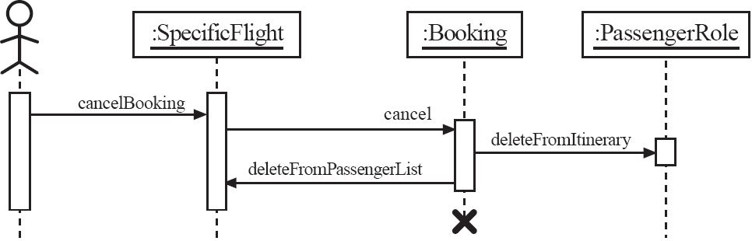
Sequence diagrams – an example with object deletion
  If an object’s life ends, this is shown with an X at the end of the lifeline
© Lethbridge/Laganière 2005
Chapter 8: Modelling Interactions and Behaviour

Slide 11
Exercise E8.1
Draw a sequence diagram representing the following interactions:
  A client searches for a book in a library. He or she then asks to borrow the book. If a copy of this book is available, a loan object is created.

Slide 12
Exercise E8.1
Draw a sequence diagram representing the following interactions:
  A client wishes to open a new account at a bank branch. To do so, his instance of class Client must first be retrieved from the central bank server. For a new client, an instance of Client must be created. An instance of BankAccount is then created using the Client object. A deposit must then immediately follow, to complete the account creation process.

Slide 13
Communication diagrams: an example
Recall:
*
*
*
*
*
Course
*
CourseSection
*
*
*
*
*
*
Registration
Student
getPrerequisite
requestToRegister
addToSchedule
addToRegistrationList
hasPassedCourse
© Lethbridge/Laganière 2001
Chapter 8: Modelling Interactions and Behaviour

Slide 14
Communication diagrams: an example
Recall:
*
*
*
*
*
Course
*
CourseSection
*
*
*
*
*
*
Registration
Student
getPrerequisite
requestToRegister
addToSchedule
addToRegistrationList
hasPassedCourse
1: <<create>>
2: addToSchedule
:CourseSection
:Registration
:Student
3: addToRegistrationList
© Lethbridge/Laganière 2001
Chapter 8: Modelling Interactions and Behaviour

Slide 15
Communication diagrams: an example
1: <<create>>
2: addToSchedule
:CourseSection
:Registration
:Student
3: addToRegistrationList
Compare:
:CourseSection
:Student
requestToRegister
:Registration
<<create>>
addToSchedule
addToRegistrationList
© Lethbridge/Laganière 2001
Chapter 8: Modelling Interactions and Behaviour

Slide 16
Communication diagrams
Communication diagrams emphasise how the objects collaborate in order to realize an interaction
  A communication diagram is a graph with the objects as the vertices.
  Communication links are added between objects
  Messages are attached to these links.
    Shown as arrows labelled with the message name
  Time ordering is indicated by prefixing the message with some numbering scheme.
© Lethbridge/Laganière 2005
Chapter 8: Modelling Interactions and Behaviour

Slide 17
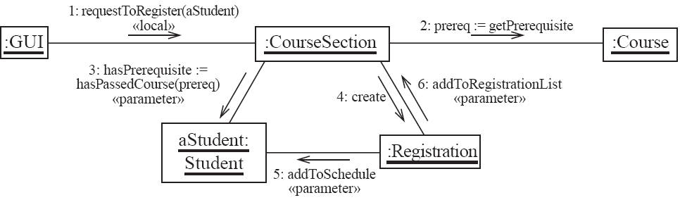
Communication diagrams – same example, more details
© Lethbridge/Laganière 2005
Chapter 8: Modelling Interactions and Behaviour

Slide 18
Communication links
  A communication link can exist between two objects whenever it is possible for one object to send a message to the other one.
  Several situations can make this message exchange possible:
    1. The classes of the two objects have an association between them.
      This is the most common case.
      If all messages are sent in the same direction, then probably the association can be made unidirectional.
© Lethbridge/Laganière 2005
Chapter 8: Modelling Interactions and Behaviour

Slide 19
Other communication links
    2. The receiving object is stored in a local variable of the sending method.
      This often happens when the object is created in the sending method or when some computation returns an object .
      The stereotype to be used is «local» or [L].
    3. A reference to the receiving object has been received as a parameter of the sending method.
      The stereotype is «parameter» or [P].
© Lethbridge/Laganière 2005
Chapter 8: Modelling Interactions and Behaviour

Slide 20
Other communication links
    4. The receiving object is global.
      This is the case when a reference to an object can be obtained using a static method.
      The stereotype «global», or a [G] symbol is used in this case.
    5. The objects communicate over a network.
      We suggest to write «network».
© Lethbridge/Laganière 2005
Chapter 8: Modelling Interactions and Behaviour

Slide 21
Exercise E8.3
Draw communication diagrams for the interactions described in Exercise E8.1:
  A client searches for a book in a library. He or she then asks to borrow the book. If a copy of this book is available, a loan object is created.

Slide 22
Exercise E8.3
Draw communication diagrams for the interactions described in Exercise E8.1:
  A client wishes to open a new account at a bank branch. To do so, his instance of class Client must first be retrieved from the central bank server. For a new client, an instance of Client must be created. An instance of BankAccount is then created using the Client object. A deposit must then immediately follow, to complete the account creation process.

Slide 23
How to choose between using a sequence or communication diagram
Sequence diagrams
  Make explicit the time ordering of the interaction.
    Use cases make time ordering explicit too
    So sequence diagrams are a natural choice when you build an interaction model from a use case.
  Make it easy to add details to messages.
    Communication diagrams have less space for this
© Lethbridge/Laganière 2005
Chapter 8: Modelling Interactions and Behaviour

Slide 24
How to choose between using a sequence or communication diagram
Communication diagrams
  Can be seen as a projection of the class diagram
    Might be preferred when you are deriving an interaction diagram from a class diagram.
    Are also useful for validating class diagrams.
© Lethbridge/Laganière 2005
Chapter 8: Modelling Interactions and Behaviour

Slide 25
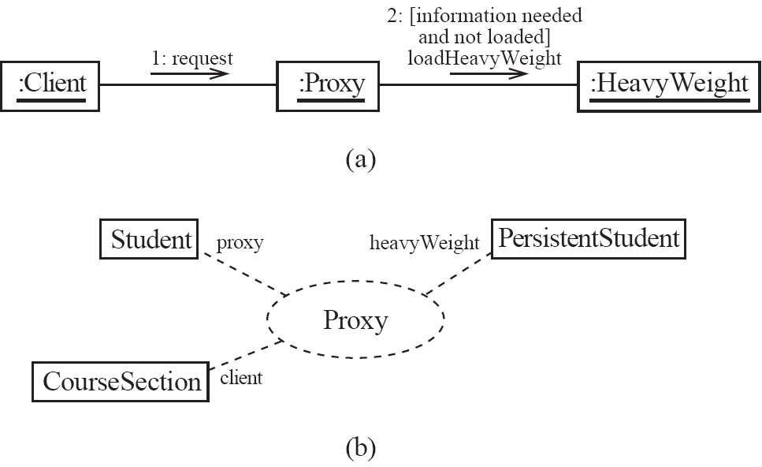
Communication diagrams and patterns
A communication diagram can be used to represent aspects of a design pattern
© Lethbridge/Laganière 2005
Chapter 8: Modelling Interactions and Behaviour

Slide 26
8.2 State Diagrams
A state diagram describes the behaviour of a system, some part of a system, or an individual object.
  At any given point in time, the system or object is in a certain state.
    Being in a state means that it is will behave in a specific way in response to any events that occur.
  Some events will cause the system to change state.
    In the new state, the system will behave in a different way to events.
  A state diagram is a directed graph where the nodes are states and the arcs are transitions.
© Lethbridge/Laganière 2005
Chapter 8: Modelling Interactions and Behaviour

Slide 27
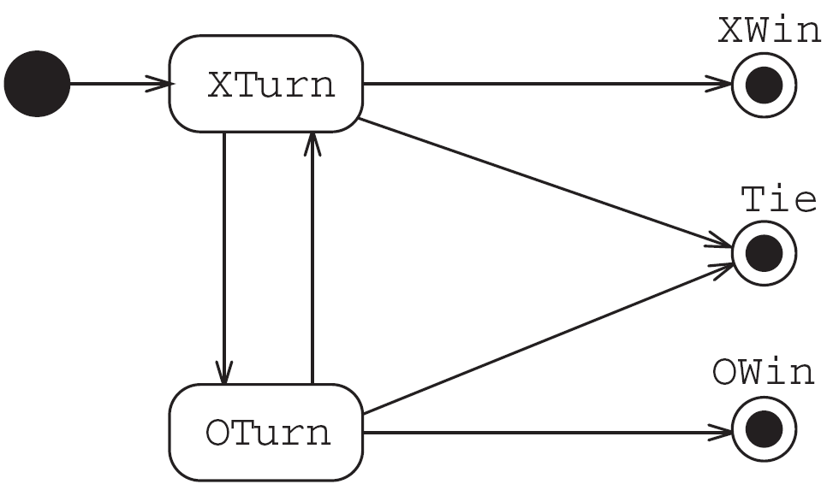
State diagrams – an example
  tic-tac-toe game
© Lethbridge/Laganière 2005
Chapter 8: Modelling Interactions and Behaviour

Slide 28
States
  At any given point in time, the system is in one state.
  It will remain in this state until an event occurs that causes it to change state.
  A state is represented by a rounded rectangle containing the name of the state.
  Special states:
    A black circle represents the start state
    A circle with a ring around it represents an end state
© Lethbridge/Laganière 2005
Chapter 8: Modelling Interactions and Behaviour

Slide 29
Transitions
  A transition represents a change of state in response to an event.
    It is considered to occur instantaneously.
  The label on each transition is the event that causes the change of state.
© Lethbridge/Laganière 2005
Chapter 8: Modelling Interactions and Behaviour

Slide 30
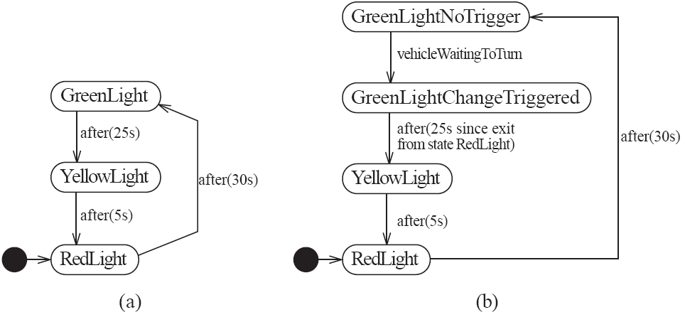
State diagrams – an example of transitions with time-outs and conditions
© Lethbridge/Laganière 2005
Chapter 8: Modelling Interactions and Behaviour

Slide 31
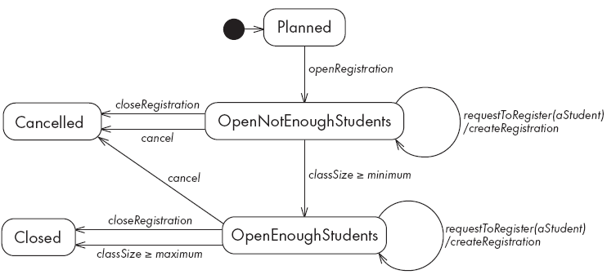
State diagrams – an example with conditional transitions
© Lethbridge/Laganière 2005
Chapter 8: Modelling Interactions and Behaviour

Slide 32
Exercise E8.4
Enhance Tic-Tac-Toe state diagram (next slide) to show conditions that should be present to determine when the system should transition to each of the end states (XWin, OWin, Tie) or to the regular states (XTurn, OTurn).

Slide 33
State diagrams – an example
  tic-tac-toe game
© Lethbridge/Laganière 2005
Chapter 8: Modelling Interactions and Behaviour

Slide 34
Exercise E8.5
Given the course section state diagram (see next slide), in what state would the system be after the following sequences of events? Assume minimum=3, maximum=5
  openRegistration, requestToRegister (repeated twice), cancel
  openRegistration, requestToRegister (repeated 8 times), closeRegistration

Slide 35
State diagrams – an example with conditional transitions
© Lethbridge/Laganière 2005
Chapter 8: Modelling Interactions and Behaviour

Slide 36
Exercise E8.6
Enhance the course section state diagram to handle the following situations:
  The course section can be cancelled when in any state, except after it has been taught
  A student can drop out at any time, except after the course section has been taught

Slide 37
Activities in state diagrams
  An activity is something that takes place while the system is in a state.
    It takes a period of time.
    The system may take a transition out of the state in response to completion of the activity,
    Some other outgoing transition may result in:
      The interruption of the activity, and
      An early exit from the state.
© Lethbridge/Laganière 2005
Chapter 8: Modelling Interactions and Behaviour

Slide 38
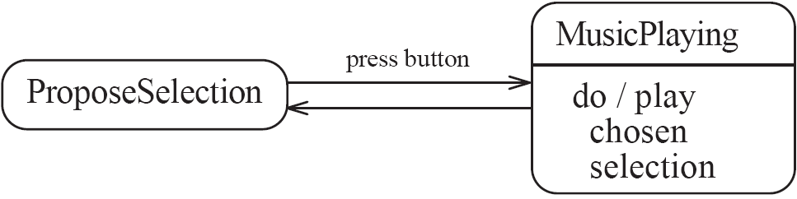
State diagram – an example with activity
© Lethbridge/Laganière 2005
Chapter 8: Modelling Interactions and Behaviour

Slide 39
Actions in state diagrams
  An action is something that takes place effectively instantaneously
    When a particular transition is taken,
    Upon entry into a particular state, or
    Upon exit from a particular state
  An action should consume no noticeable amount of time
© Lethbridge/Laganière 2005
Chapter 8: Modelling Interactions and Behaviour

Slide 40
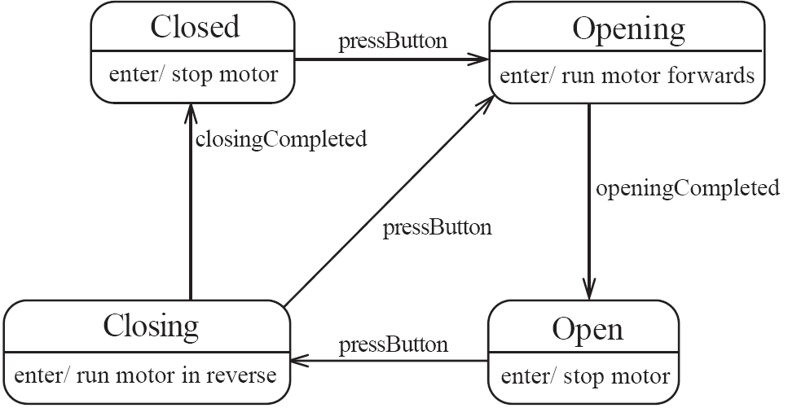
State diagram – an example with actions
© Lethbridge/Laganière 2005
Chapter 8: Modelling Interactions and Behaviour

Slide 41
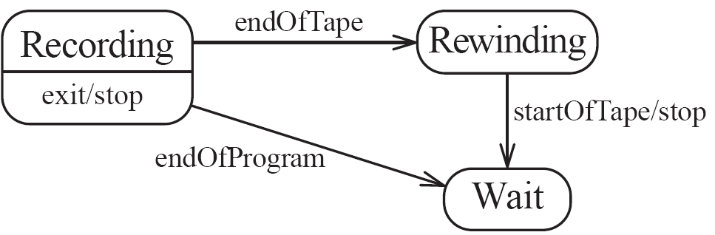
State diagrams – another example
© Lethbridge/Laganière 2005
Chapter 8: Modelling Interactions and Behaviour

Slide 42
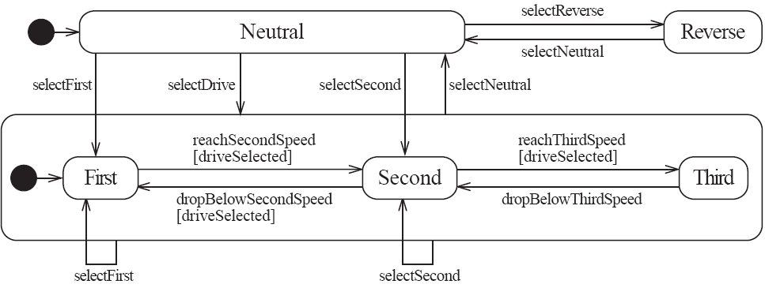
Nested substates and guard conditions
A state diagram can be nested inside a state.
  The states of the inner diagram are called substates.
© Lethbridge/Laganière 2005
Chapter 8: Modelling Interactions and Behaviour

Slide 43
Exercise E8.11
There is a missing transition in the automatic transmission state diagram. What is it?

Slide 44
Exercise E8.12
Modify the automatic transmission state diagram so that it correctly incorporates the "Park" control.

Slide 45
State diagrams: recall student registration example:
Planned
openRegistration
closeRegistration
requestToRegister
(aStudent)
Cancelled
OpenNotEnoughStudents
cancel
/createRegistration
cancel
classSize >= minimum
closeRegistration
Closed
OpenEnoughStudents
requestToRegister
(aStudent)
classSize >= maximum
/createRegistration
© Lethbridge/Laganière 2001
Chapter 8: Modelling Interactions and Behaviour

Slide 46
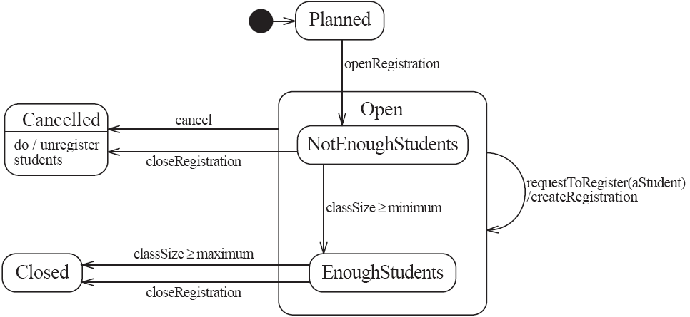
State diagram – an example with substates
© Lethbridge/Laganière 2005
Chapter 8: Modelling Interactions and Behaviour

Slide 47
8.3 Activity Diagrams
  An activity diagram is like a state diagram.
    Except most transitions are caused by internal events, such as the completion of a computation.
  An activity diagram
    Can be used to understand the flow of work that an object or component performs.
    Can also be used to visualize the interrelation and interaction between different use cases.
    Is most often associated with several classes.
  One of the strengths of activity diagrams is the representation of concurrent activities.
© Lethbridge/Laganière 2005
Chapter 8: Modelling Interactions and Behaviour

Slide 48
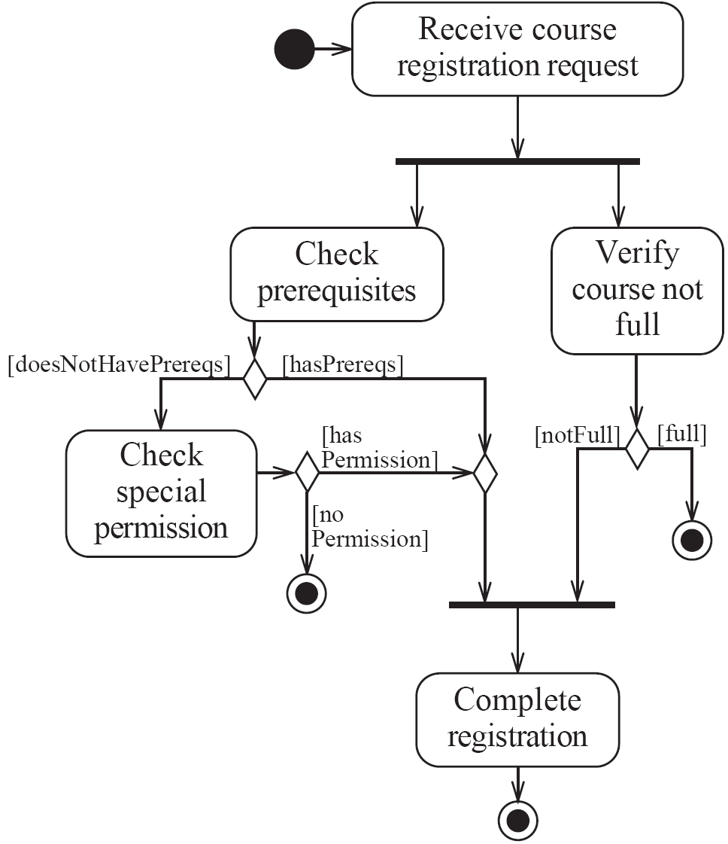
Activity diagrams – an example
© Lethbridge/Laganière 2005
Chapter 8: Modelling Interactions and Behaviour

Slide 49
Representing concurrency
  Concurrency is shown using forks, joins and rendezvous.
    A fork has one incoming transition and multiple outgoing transitions.
      The execution splits into two concurrent threads.
    A rendezvous has multiple incoming and multiple outgoing transitions.
      Once all the incoming transitions occur all the outgoing transitions may occur.
© Lethbridge/Laganière 2005
Chapter 8: Modelling Interactions and Behaviour

Slide 50
Representing concurrency
    A join has multiple incoming transitions and one outgoing transition.
      The outgoing transition will be taken when all incoming transitions have occurred.
      The incoming transitions must be triggered in separate threads.
      If one incoming transition occurs, a wait condition occurs at the join until the other transitions occur.
© Lethbridge/Laganière 2005
Chapter 8: Modelling Interactions and Behaviour

Slide 51
Swimlanes
Activity diagrams are most often associated with several classes.
  The partition of activities among the existing classes can be explicitly shown using swimlanes.
© Lethbridge/Laganière 2005
Chapter 8: Modelling Interactions and Behaviour

Slide 52
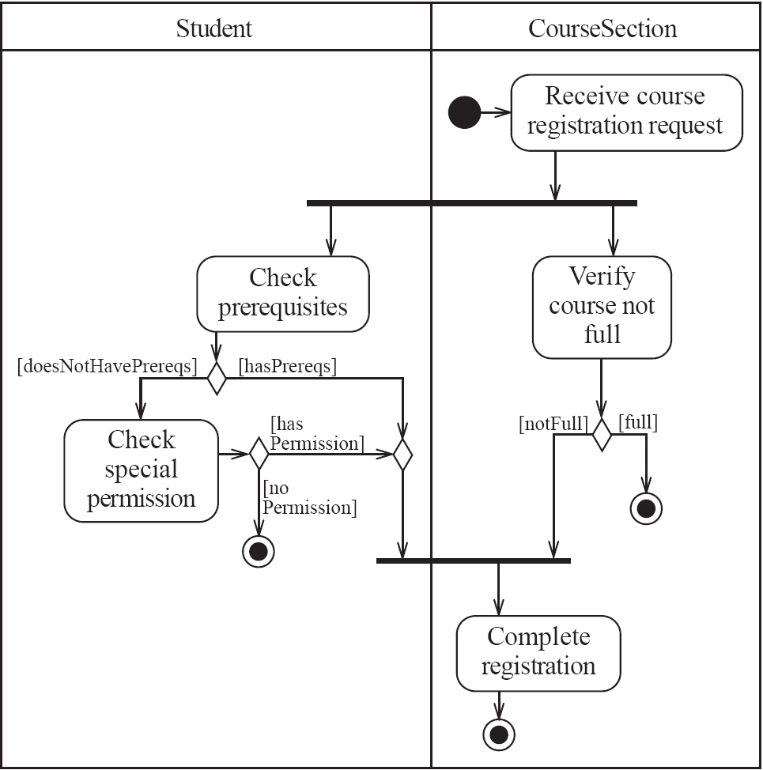
Activity diagrams – an example with swimlanes
© Lethbridge/Laganière 2005
Chapter 8: Modelling Interactions and Behaviour

Slide 53
8.4 Implementing Classes Based on Interaction and State Diagrams
  You should use these diagrams for the parts of your system that you find most complex.
    I.e. not for every class
  Interaction, activity and state diagrams help you create a correct implementation.
  This is particularly true when behaviour is distributed across several use cases.
    E.g. a state diagram is useful when different conditions cause instances to respond differently to the same event.
© Lethbridge/Laganière 2005
Chapter 8: Modelling Interactions and Behaviour

Slide 54
Recall student registration example:
Planned
openRegistration
closeRegistration
requestToRegister
(aStudent)
Cancelled
OpenNotEnoughStudents
cancel
/createRegistration
cancel
classSize >= minimum
closeRegistration
Closed
OpenEnoughStudents
requestToRegister
(aStudent)
classSize >= maximum
/createRegistration
© Lethbridge/Laganière 2001
Chapter 8: Modelling Interactions and Behaviour

Slide 55
Example: The CourseSection class
States:
  ‘Planned’:
    closedOrCancelled == false && open == false
  ‘Cancelled’:
    closedOrCancelled == true &&
    registrationList.size() == 0
  ‘Closed’ (course section is too full, or being taught):
    closedOrCancelled == true &&
    registrationList.size() > 0
© Lethbridge/Laganière 2005
Chapter 8: Modelling Interactions and Behaviour

Slide 56
Example: The CourseSection class
States:
  ‘Open’ (accepting registrations):
    open == true
  ‘NotEnoughStudents’ (substate of ‘Open’):
    open == true &&
    registrationList.size() < course.getMinimum()
  ‘EnoughStudents’ (substate of ‘Open’):
    open == true &&
    registrationList.size() >= course.getMinimum()
© Lethbridge/Laganière 2005
Chapter 8: Modelling Interactions and Behaviour

Slide 57
Example: The CourseSection class
Class diagram
© Lethbridge/Laganière 2005
Chapter 8: Modelling Interactions and Behaviour

Slide 58
Example: The CourseSection class
public class CourseSection
{
// The many-1 association to class Course
private Course course;
// The 1-many association to class Registration
private List registrationList;
// The following are present only to determine the state
// The initial state is 'Planned‘
private boolean open = false;
private boolean closedOrCanceled = false;
© Lethbridge/Laganière 2005
Chapter 8: Modelling Interactions and Behaviour

Slide 59
Example: The CourseSection class
public CourseSection(Course course)
{
this.course = course;
registrationList = new LinkedList();
}
public void openRegistration()
{
if(!closedOrCanceled) // must be in 'Planned' state
{
open = true; // to 'OpenNotEnoughStudents' state
}
}
© Lethbridge/Laganière 2005
Chapter 8: Modelling Interactions and Behaviour

Slide 60
Example: The CourseSection class
public void closeRegistration()
{
// to 'Canceled' or 'Closed' state
open = false;
closedOrCanceled = true;
if (registrationList.size() < course.getMinimum())
{
unregisterStudents(); // to 'Canceled' state
}
}
public void cancel()
{
// to 'Canceled' state
open = false;
closedOrCanceled = true;
unregisterStudents();
}
© Lethbridge/Laganière 2005
Chapter 8: Modelling Interactions and Behaviour

Slide 61
Example: The CourseSection class
// Private method to remove all registrations
// Activity associated with 'Canceled' state.
private void unregisterStudents()
{
Iterator it = registrationList.iterator();
while (it.hasNext())
{
Registration r = (Registration)it.next();
r.unregisterStudent();
it.remove();
}
}
© Lethbridge/Laganière 2005
Chapter 8: Modelling Interactions and Behaviour

Slide 62
Recall Sequence Diagram:
© Lethbridge/Laganière 2005
Chapter 8: Modelling Interactions and Behaviour

Slide 63
Example: The CourseSection class
public void requestToRegister(Student student)
{
if (open) // must be in one of the two 'Open' states
{
// The interaction specified in the sequence diagram
Course prereq = course.getPrerequisite();
if (student.hasPassedCourse(prereq))
{
// Indirectly calls addToRegistrationList
new Registration(this, student);
}
// Check for automatic transition to 'Closed' state
if (registrationList.size() >= course.getMaximum())
{
// to 'Closed' state
open = false;
closedOrCanceled = true;
}
}
}
© Lethbridge/Laganière 2005
Chapter 8: Modelling Interactions and Behaviour

Slide 64
Example: The CourseSection class
// Called within this package only, by the constructor of
// Registration to ensure the link is bi-directional
void addToRegistrationList(Registration newRegistration)
{
registrationList.add(newRegistration);
}
}
© Lethbridge/Laganière 2005
Chapter 8: Modelling Interactions and Behaviour

Slide 65
8.5 Difficulties and Risks in Modelling Interactions and Behaviour
Dynamic modelling is a difficult skill
  In a large system there are a very large number of possible paths a system can take.
  It is hard to choose the classes to which to allocate each behaviour:
    Ensure that skilled developers lead the process, and ensure that all aspects of your models are properly reviewed.
    Work iteratively:
      Develop initial class diagrams, use cases, responsibilities, interaction diagrams and state diagrams;
      Then go back and verify that all of these are consistent, modifying them as necessary.
    Drawing different diagrams that capture related, but distinct, information will often highlight problems.
© Lethbridge/Laganière 2005
Chapter 8: Modelling Interactions and Behaviour

